Slide 1
MPCA Mini Project
Project Title : Arcade game using 8x32 Display
Section : A
Students Name : Danish Ebadulla, Joseph Dominic, Tejas Srinivasan
SRN : PES1201800096,PES1201800328,PES1201800110

Slide 2
Problem Statement
To create an Arcade of games (Stack,Snake,Space Shooter,Hangman,Tetris) that can be played by a single player on a LED screen interface using Arduino code that interfaces with a microcontroller, in a robust setup along with additional functionality like audio output etc.
This routine would also help us in learning how to work with the Arduino Uno,programming it with help of the Arduino IDE and using sensors to interface with the board in order to get the desired results.

Slide 3
Introduction
Simple yet classic games like Stack, Snake,Space Shooter, Hangman, Tetris etc. are a great way to have fun and learn at the same time.
We have attempted to bring back some of the childhood nostalgia by implementing some of the popular games using an Arduino, LED Screen and simple components like buttons for the user to play and beat the arcade!
As of this point in time, only the Stacking game has been implemented in arcade.However we are optimistic of being able to add more games to it.
The code was written in C++ on the Arduino IDE.
The code and a video demo of the arcade can be found here -https://drive.google.com/drive/folders/19m_YIesRugtDElltfXU3E0Whh7ANtz6G

Slide 4
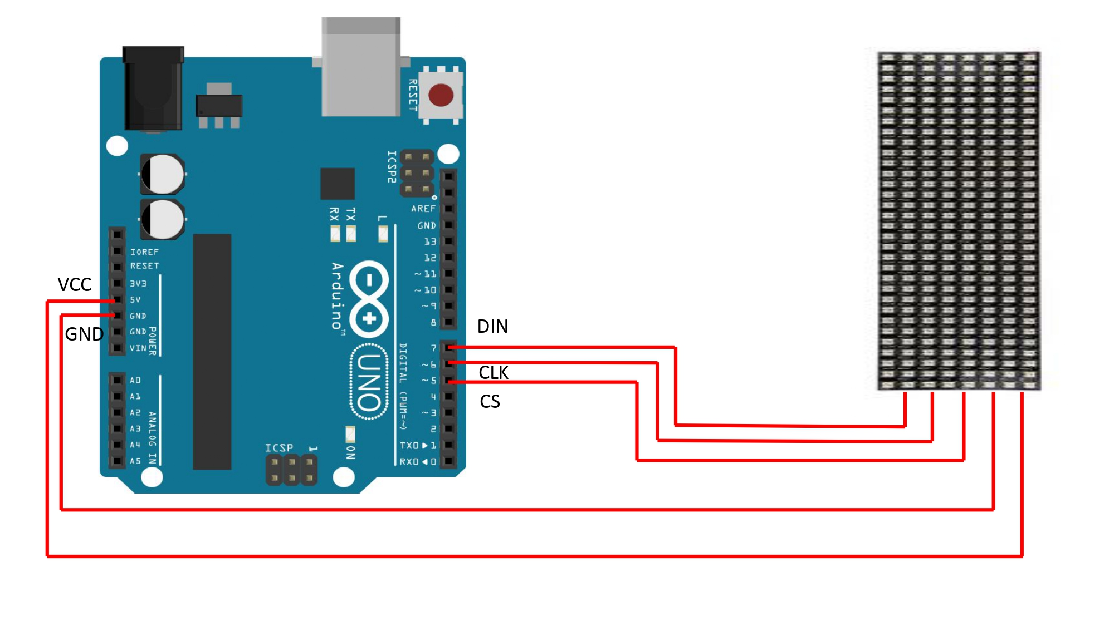
Block Diagram/Circuit Diagram

Slide 5
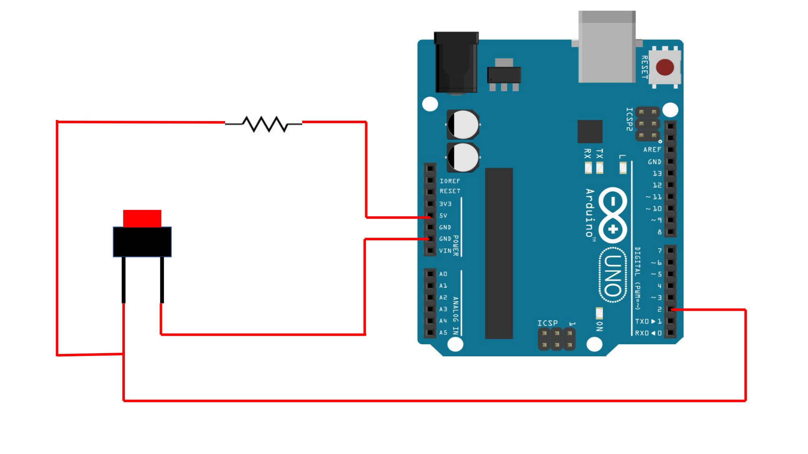
Block Diagram/Circuit Diagram

Slide 6
Required Components
Arduino Uno
8X32 LED Screens
Connecting wires
Push Buttons (x3)
Speaker
10K ohms resistor
Breadboard

Slide 7
Project Explanation
Since we have implemented only the Stacking game so far, the explanation is for that game. If time permits to implement the other arcade games, the explanation for those will added here as well.
The MaxMatrix header file was used for creating an instance of the matrix.
Pins 5,6 and 7 correspond to CLK,DIN and CIN respectively.
A maximum of 4 modules were used.
The setup function sets the intensity of brightness to 1 and initializes pin 2 as the input pin.
Display functions for each of the 26 letters of the alphabet were written by mapping each dot (pixel) in the LED display to different row and column combinations (according to a simple mapping function written in the code file) to uniquely represent each individual letter.

Slide 8
Project Explanation
The move function is of type ‘byte’ and decides the side where the oscillations starts, repeats the action in a loop and checks if the user has hit the button to delay/exit the loop.The function also reverses the direction on encountering an edge by incrementing/decrementing position and returns the final spot where the user stops the block.
The setrow() function switches on/off all LEDs between s and e on the row mr, if the boolean value returned is true and switches them on and off if the value returned is false.
The main function acts as a helper function to set the base of the stack, the initial length etc. and executes a loop that runs till the user either loses or reaches the top, by calling the move function. The appropriate function is called based on how the game develops.
Depending on how the user plays the game, the you_win and the you_lose functions display the resulting message by calling the required displayed functions for the letters sequentially with the appropriate delays.

Slide 9
Application
While we have restricted the application of our display to arcade games,a 8x32 LED display with mapping functions for all letters of the alphabet can be used as a digital information banner or a static display board.
The current setup is restricted to be used only for recreational purposes. It can serve as a way to kill time when bored, have fun competing and playing with friends or family and even improve reflexes to some extent.

Slide 10
Thank You

